Slide 1
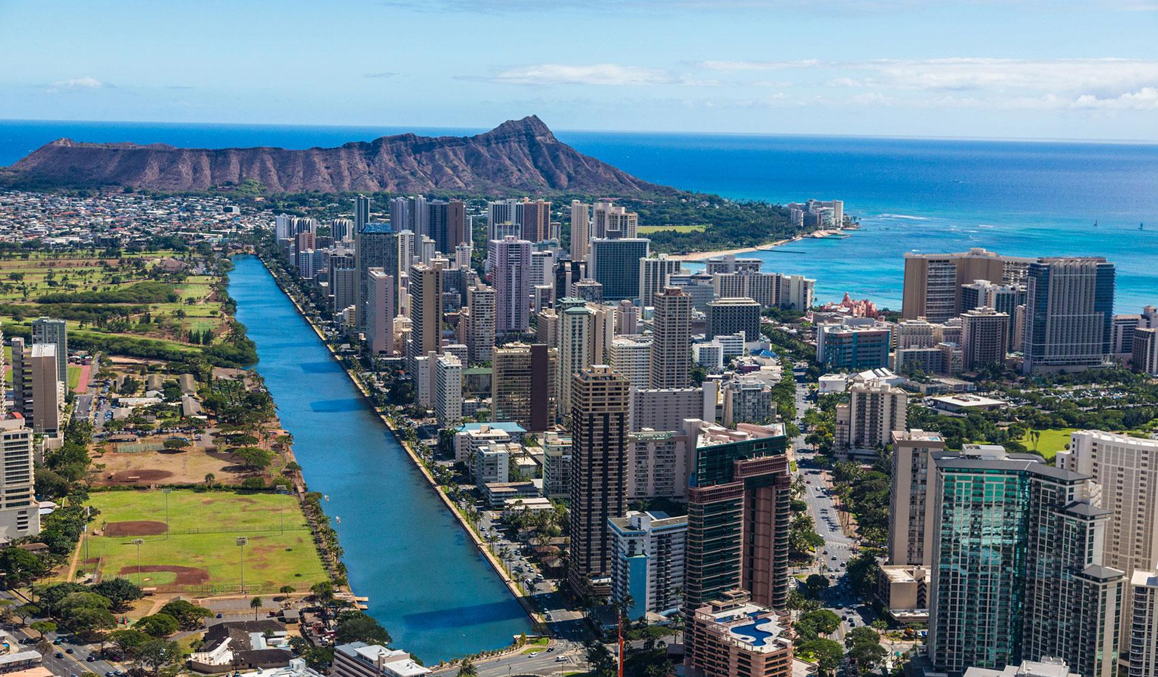
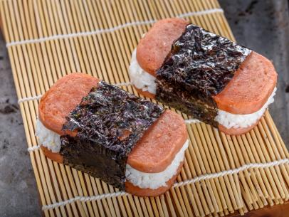
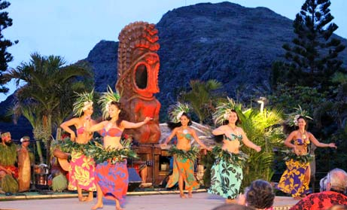
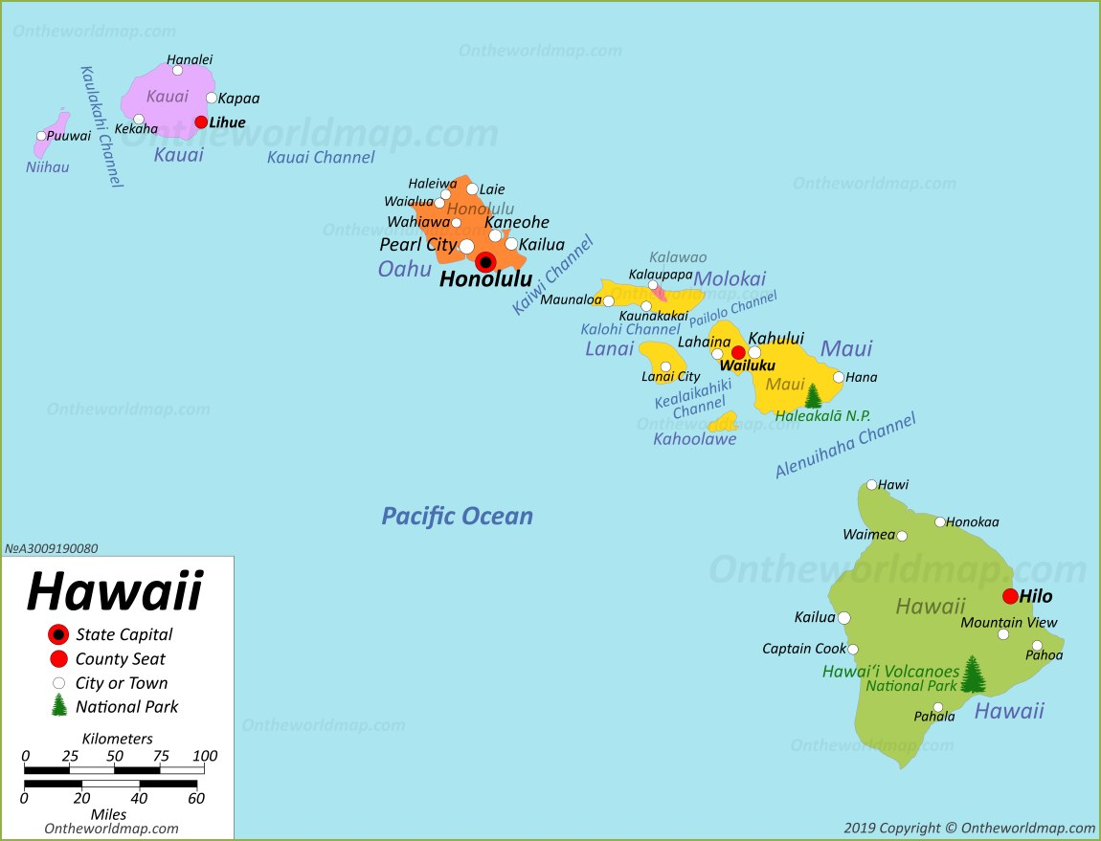

Pics of hawaii
Food from hawaii
cultures
Hawaii(Honolulu)/ 76 degrees, 80% humidity
The islands of Hawaii offer a range of landscapes, from pristine beaches with crystal-clear waters to lush rainforests, volcanic mountains, and cascading waterfalls. The active volcanoes of Hawaii, such as Kilauea and Mauna Loa, provide unique opportunities for exploration and witness the creation of new land. Tourism plays a vital role in Hawaii's economy, attracting millions of visitors each year. Travelers flock to the islands to experience activities like surfing, snorkeling, hiking, and enjoying the vibrant nightlife and culinary scene
Other location
Ocean/animals

Slide 2
Pics of hawaii
Food from hawaii
cultures
Hawaii(Honolulu)/ 76 degrees, 80% humidity
The islands of Hawaii offer a range of landscapes, from pristine beaches with crystal-clear waters to lush rainforests, volcanic mountains, and cascading waterfalls. The active volcanoes of Hawaii, such as Kilauea and Mauna Loa, provide unique opportunities for exploration and witness the creation of new land. Tourism plays a vital role in Hawaii's economy, attracting millions of visitors each year. Travelers flock to the islands to experience activities like surfing, snorkeling, hiking, and enjoying the vibrant nightlife and culinary scene
Other island
Ocean/animals

Slide 3
Select city:
Hawaii(Honolulu)/ 76 degrees, 80% humidity
The islands of Hawaii offer a range of landscapes, from pristine beaches with crystal-clear waters to lush rainforests, volcanic mountains, and cascading waterfalls. The active volcanoes of Hawaii, such as Kilauea and Mauna Loa, provide unique opportunities for exploration and witness the creation of new land. Tourism plays a vital role in Hawaii's economy, attracting millions of visitors each year. Travelers flock to the islands to experience activities like surfing, snorkeling, hiking, and enjoying the vibrant nightlife and culinary scene
Pics of hawaii
Food from hawaii
Cultures

